Slide 1
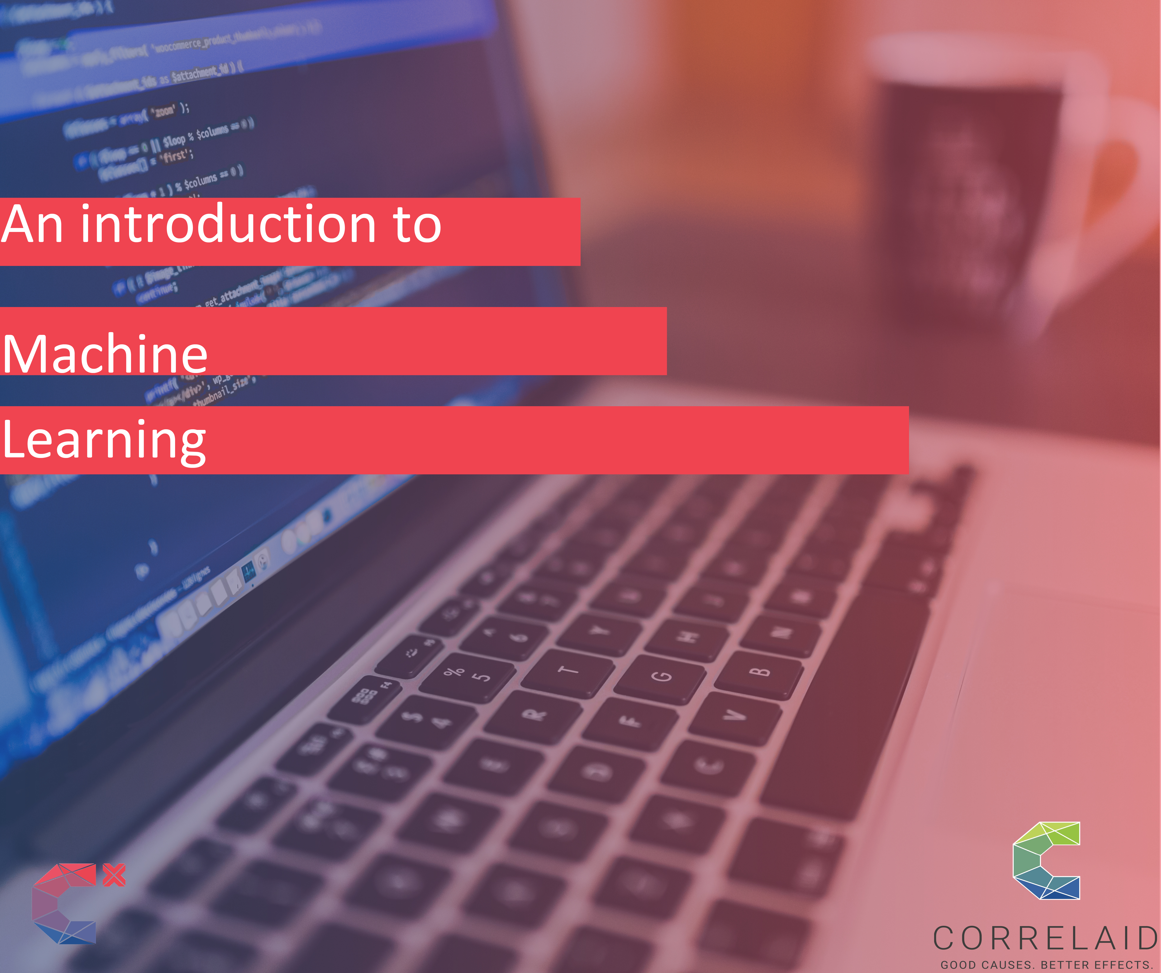

Slide 2

Machine learning: what is it about?
When to use it?
How does it fit in the larger process of data Analytics?

Slide 3
1. Definition
Here we will adopt the general definitions
Machine Learning is the field of study that gives computers the ability to learn without being explicitly programmed. (Arthur Samuel, 1959 )
Machine Learning is the science (and art) of programming computers so they can learn from data.

Slide 4
Definition (cont.)
Grew out of artificial intelligence within computer science. Teaches computers by example.
Is this a chair?

Slide 5
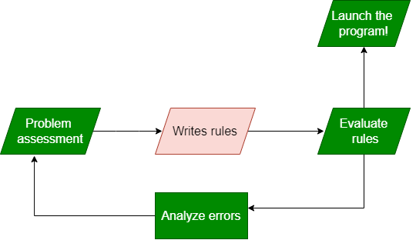
2. When to Use ML: Problem Solving Approach I
Problems for which existing solutions require a lot of human assistance or long lists of rules
Complex problems for which there is no good solution at all using a traditional approach
Solving problem with Tradition approach

Slide 6
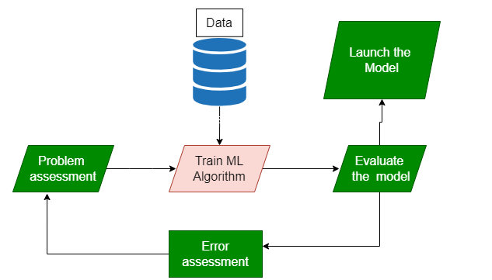
When to Use ML: Problem Solving Approach II
Fluctuating environments: a Machine Learning system can adapt to new data
Cost/benefit : If the cost of implementing a given task can be reduced
Solving problem with Machine learning

Slide 7
3. Types of Learning Systems
Most statistical learning problems fall into one of two categories: supervised or unsupervised
Supervised means for each observation of the predictor measurement(s) xi, i = 1, . . . , n there is an associated response measurement yi.
We wish to fit a model that relates the response to the predictors, with the aim of accurately predicting the response for future observations.

Slide 8
Types of Learning Systems(cont.)
“Supervised” means that the training data has ground truth labels to learn from
(not a chair)
(chair)
(not a chair)
chair?
(chair)
(chair)
(not a chair)
(not a chair)
Notes:
Using our example of classifying a chair and non chair objects
We can start labeling objects to create training dataset which can be used to teach a model later

Slide 9
Types of Learning Systems (cont.)
Unsupervised learning describes the somewhat more challenging situation in which for every observation i = 1, . . . , n, we observe a vector of measurements x_{i} but no associated response y_{i}.
It is not possible to fit a supervised learning model, since there is no response variable to predict.
Briefly, the situation is referred to as unsupervised because we lack a response variable that can supervise our analysis.

Slide 10
Types of Learning Systems (cont.)
“Unsupervised” means that the training data has no ground truth labels to learn from.

Slide 11
4. Supervised problem: Regression
When to use regression?
For predicting real-valued outcomes, example:
How many visitors will arrive at our website next week?
What is the daily average temperature and rainfall?
Can we predict someone’s life expectancy from their financial and social information?

Slide 12
Regression(cont.)
Given training set (x_{i,}y_{i}) for i=1…n, we want to create a regression model f(x) that can predict label y for a new x.
100
Years
f(x) = function(Average annual salary per country)
f(x)
Life expectancy
0
100 K
0
Average annual salary per country

Slide 13
Regression (cont.)
In case multiple regression, we get many observations and each observation is represented by a set of numbers
Life expectancy
A person is represented as: [ 5 3 120 12 1 0 ….. ] 84
[ 0 0 89 5 1 1 ….. ] 40
[ 1 0 20 0 0 1 ….. ] 50
Features, called X
Labels, called Y

Slide 14
Regression Application
Predicting life expectancy given other variables such as (GDP, Democracy, Financial support, security score, etc)
Predicting rainfall given the location X,Y coordinates, elevation, vegetation, etc.
Predicting yield based on quality of soil, rain, fertilizer rate, crop type, etc.
Notes:
Take away message

Slide 15
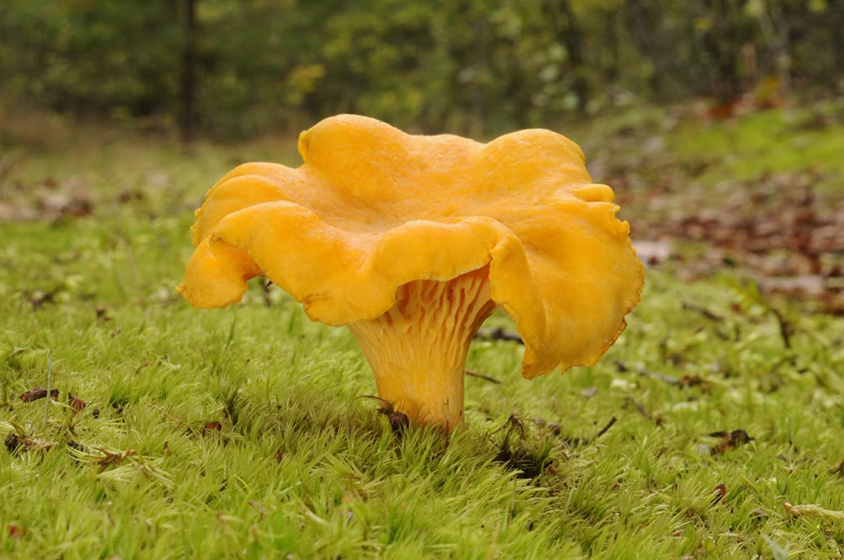
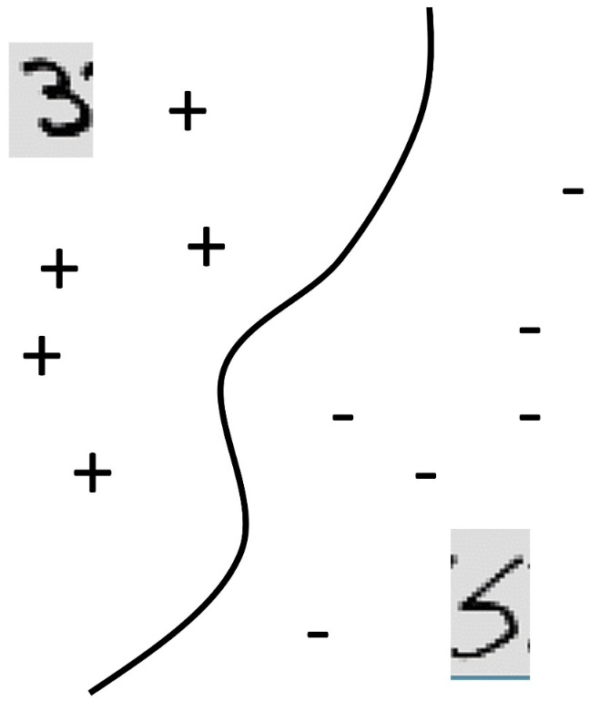
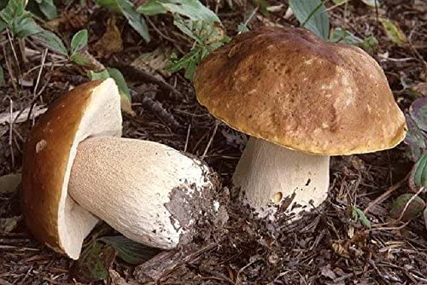
5. Supervised problem: Classification
Formally, given training set (x_{i,}y_{i}) for i=1…n, we want to create a classification model f(x) that can predict label y for a new x.
20
f(x) = function(color of mushroom)
Species
0
Green
Color of mushroom
Brown

Slide 16
Classification (cont.)
In case of many attributes, each observation is represented by a set of features.
Mushroom is represented as: [ red bell 12 1 0 ….. ] edible
[ green canonical 5 1 1 ….. ] unknown
[ brown convex 0 0 1 ….. ] poisonous
Features, called X
Labels, called Y
(Predictors, Covariates, Explanatory Variables, Independent Variables)

Slide 17
Classification Application
Predicting species of flowers or plants based on specific characteristics of the flower or plant
Using a satellite image, we can predict whether an area is covered by a forest or agriculture fields
Predict whether a project should be funded or not based on (cost, domain, country etc. )

Slide 18
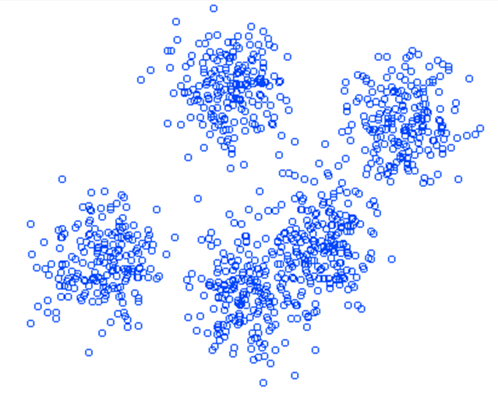
6. Unsupervised problem: Clustering
Data within a cluster should be similar to other members of the cluster.
X feature
X feature
X feature

Slide 19
Clustering (cont.)
How do we assign members in clusters?
X feature
X feature
X feature
X feature

Slide 20
Clustering (cont.)
Move the centroid toward the center of the cluster .

Slide 21
Clustering Application
Applications include:
Automatically grouping documents/webpages into topics
Clustering countries into development categories
Clustering customers based on their purchase behaviors

Slide 22
7. Model Assessment and Validation
Why is it important to assess model accuracy?
No method dominates all others over all possible data sets
On a particular data set, one specific method may work best, but some other method may work better on a similar but different data set.
Hence, it is important to decide for any given set of data which method produces the best results

Slide 23
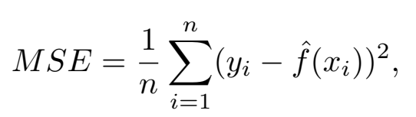
Model Assessment and Validation (cont.)
Measuring the quality of regression algorithm
To assess the quality of fit of a regression model, we need some way to measure how well its predictions match the observed data
In the regression setting, the most commonly-used measure is the mean squared error (MSE)
Notes:
That is, we need to quantify the extent to which the predicted response value for a given observation is close to the true response value for that observation.

Slide 24
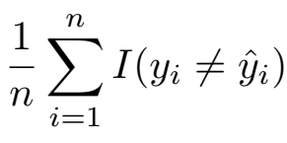
Model Assessment and Validation (cont.)
Measuring the quality of classification algorithm
The most common approach for quantifying the accuracy of our estimate ŷ_{i} is the error rate, the proportion of mistakes that are made if we apply our estimate ŷ_{i} to the validation/test observations
If y_{i}≠ŷ_{i} <=> I (y_{i}≠ŷ_{i})=1 otherwise I (y_{i}≠ŷ_{i})=0

Slide 25
Model Assessment and Validation (cont.)
Given imbalance or issues related to classification algorithm,
Two other methods are widely used :
Recall: minimizing false negatives
Precision: minimizing false positives
Produced by a confusion matrix
Predicted values |  | True values
 |  | NO | YES | TOTAL
 | NO | 9,644 (TN) | 252 (FN) | 9,896 (N)
 | YES | 23 (FP) | 81(TP) | 104 (P)
 | TOTAL | 9,667 | 333 | 10,000
In the given confusion matrix, the Recall would then be 81/333 = 0.24~ 24%, and
the Precision would be 81/104 =0.77 ~77.8%

Slide 26
Model Assessment and Validation (cont.)
Cross-Validation
Cross Validation (CV) is the most popular way to evaluate a machine learning algorithm on a dataset
You will need a dataset, an algorithm, and an evaluation measure (as discussed above) for the quality of the result

Slide 27
Model Assessment and Validation (cont.)
Cross-Validation
Train
Test
Divide the data into approximately-equally sized 10 “folds”
Train the algorithm on 9 folds, compute the evaluation measure on the last fold
Repeat this 5 or 10 times, using each fold in turn as the test fold.
Report the mean and standard deviation of the evaluation measure over the 10 folds.

Slide 28
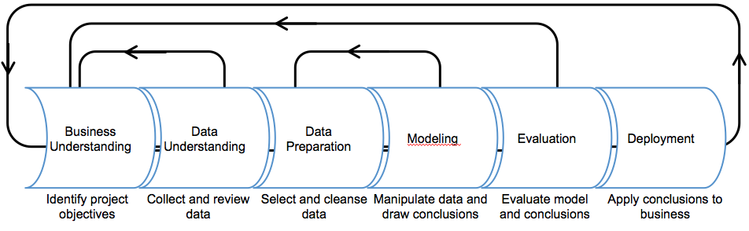
8. Data Analytics and Machine Learning Process
Knowledge Discovery in Database (1996)
Notes:
Machine Learning is just one part of a long process of data analytics

Slide 29
Take home message
ML is a subset of AI that uses algorithms to learn from the data, analyze data and make decision
It is one step in a large process of data analytics
Problems vary from predicting continuous values to predicting classes or grouping individual observations
We need appropriate model evaluation techniques to assess model performance and select best one for our problem

Slide 30
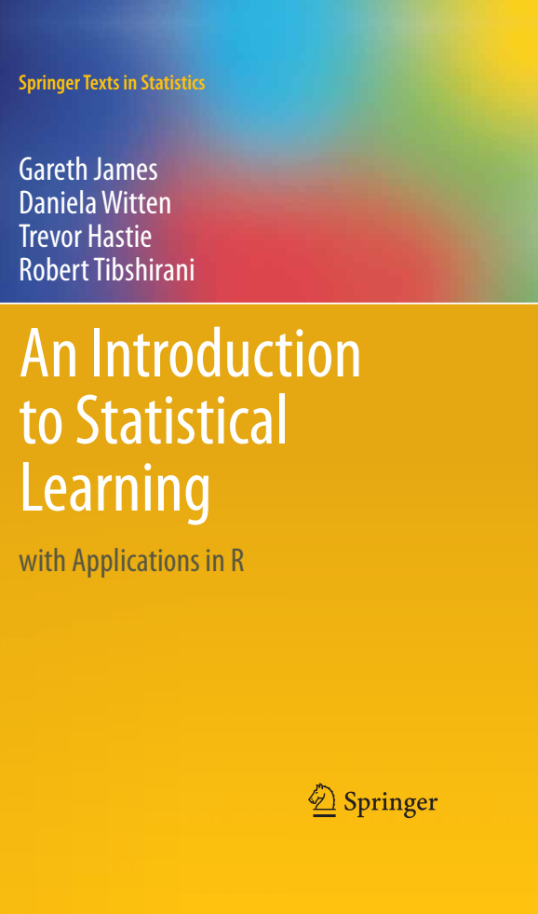
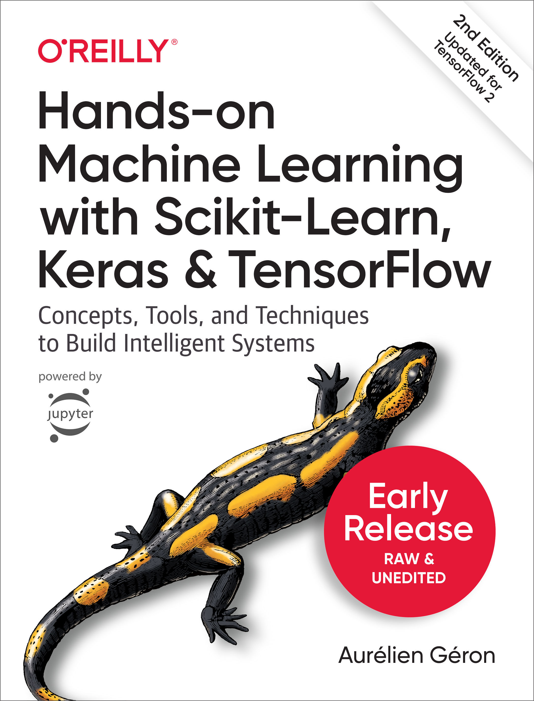
Further readings

